Slide 1
Managing Storage
Create Partitions
Manage Logical Volumes
Mount File Systems
Manage File Systems
Navigate the Linux Directory Structure
Troubleshoot Storage Issues

Slide 2

Topic A: Create Partitions
Exam Objectives:
1.4 Given a scenario, manage storage in a Linux environment.
2.3 Given a scenario, create, modify, and redirect files.
4.1 Given a scenario, analyze system properties and remediate accordingly.

Slide 3
Storage Devices
A physical component that can record data and hold it persistently.
Many types supported by Linux:
HDDs
SSDs
USB thumb drives
External storage drives
Legacy storage drives

Slide 4
File Systems
A data structure used by an operating system to store, retrieve, organize, and manage files/directories on storage devices.
Maintains info such as:
File creation/modification date.
Size of files.
Type of files.
File permissions.
Provides a structure for data storage.
Doesn't interpret data; leaves that to programs.
Vary depending on purpose, type of info stored, how to store data, security, etc.

Slide 5
Types of File Systems
File System Type | Description
FAT | Older and compatible with most OSes. Limited capabilities.
ext2 | Used to be native file system of Linux. Still supported.
ext3 | Improvements to recovery speed and data integrity. Easily upgrade from ext2 to ext3.
ext4 | One current default file system on Linux (e.g., Ubuntu). Backward-compatible with ext2 and ext3. Improvements in volume size and journaling.
XFS | The other default file system on Linux (e.g., CentOS/RHEL 7). High-performance journaling. Fast recovery with large file size support.
Notes:
Teaching Tip: The following file systems are presented from oldest to newest to provide historical context.
Teaching Tip: Journaling is covered shortly.

Slide 6
Inodes (Slide 1 of 2)
Objects that store metadata about files and directories on a file system.
Metadata: Time values, permissions/ownership, block storage locations, etc.
Each inode is given a unique number.
System/apps search inode table for appropriate inode number.
Inode table maps numbers to file/directory names.
Some file systems set a max number of inodes on creation.
Usually considers size of overall file system.
Total number of files/directories can't exceed max.
Some file system types use dynamic allocation of inodes.
Scales with capacity rather than setting a strict limit.

Slide 7
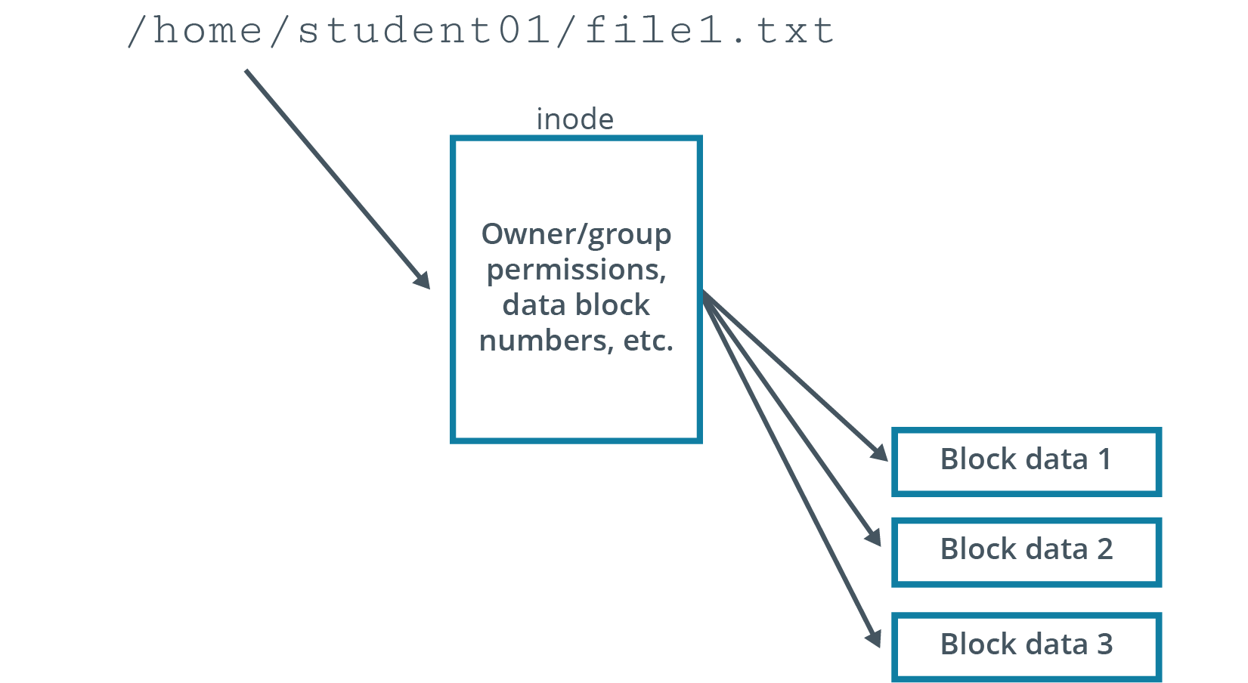
Inodes (Slide 2 of 2)

Slide 8
Journaling
A method by which a file system records changes that have not yet been made to the file system itself in an object called a journal.
File system can quickly recover after an interruption.
System references pending changes in journal to resume where it left off.
Process:
Journal describes all changes that must be made.
Background process makes each change when it is written to journal.
On system shutdown, pending changes are performed on reboot.
Incomplete entries in journal are discarded.

Slide 9
Virtual File System
A common software interface between the Linux kernel and various real file systems.
Linux supports many file system types.
Not always compatible with one another.
VFS translates file system details to kernel so it appears identical to systems.
You can mount multiple file system types in VFS.
They appear uniform to user and to apps.
Users/apps can work with file system without knowing its underlying structure.
Increases interoperability between system and software.

Slide 10
File System Labels
Assigned to file systems for easy identification.
Can be up to 16 characters long.
Use e2label for ext# file systems.
Use xfs_admin for XFS file systems.

Slide 11
Partitions
A section of a storage drive that logically acts as a separate drive.
Enable you to convert large drive into smaller chunks.
Better organization of information.
Must be formatted and assigned a file system first.
Identified using partition table.
Size of partition can vary, but cannot exceed total drive size.
Most OSes support partitioning.
Different types of data can be stored in separate locations.
Example: Separate system files from user-accessible files.

Slide 12
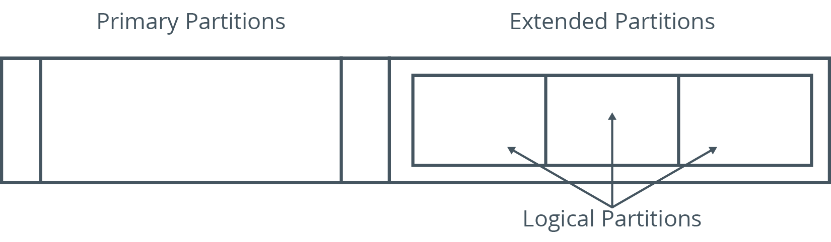
Types of Partitions (Slide 1 of 2)
12
Notes:
Teaching Tip: Consider pointing out that these partition type distinctions are only relevant to the master boot record
(MBR) partitioning scheme, an older technology. These distinctions are not as relevant to the GUID Partition Table (GPT) scheme. Both MBR and GPT are discussed in depth later in the course.

Slide 13
Types of Partitions (Slide 2 of 2)
File System Type | Description
Primary | Can contain one file system or logical drive. Swap and boot are usually primary partitions.
Extended | Can contain several file systems (logical drives). Only one, but can be further subdivided. Has separate partition table.
Logical | Part of physical drive that acts as a separate drive. Created within extended partition. No limit, but 12 max is advisable.

Slide 14
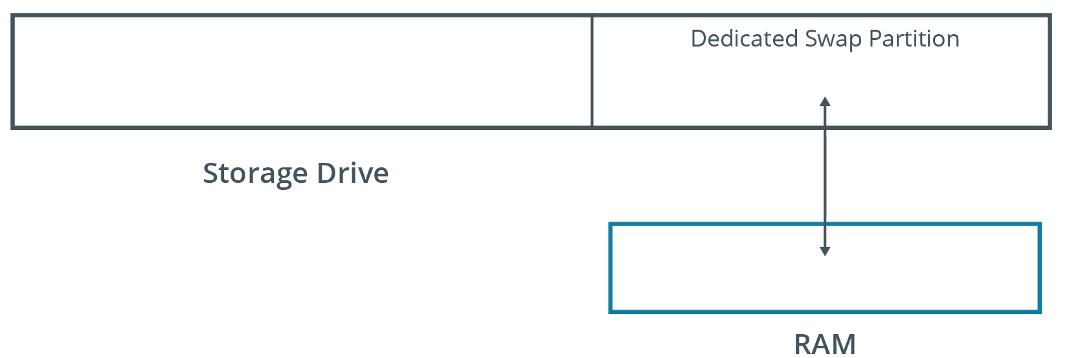
Swap Space
A partition on the storage device that is used when the system runs out of physical memory.
Linux pushes unused files from RAM to swap space.
Usually twice the physical RAM size.
Notes:
Teaching Tip: Students will learn more about configuring swap space in a later lesson.
Teaching Tip: For students familiar with Windows, swap space provides functionality similar to paging.

Slide 15
The fdisk Utility (Slide 1 of 2)
Used to create, modify, and delete partitions.
You can create new partition table or modify existing one.
Understands DOS and Linux partition tables.
Enables you to specify partition size.

Slide 16
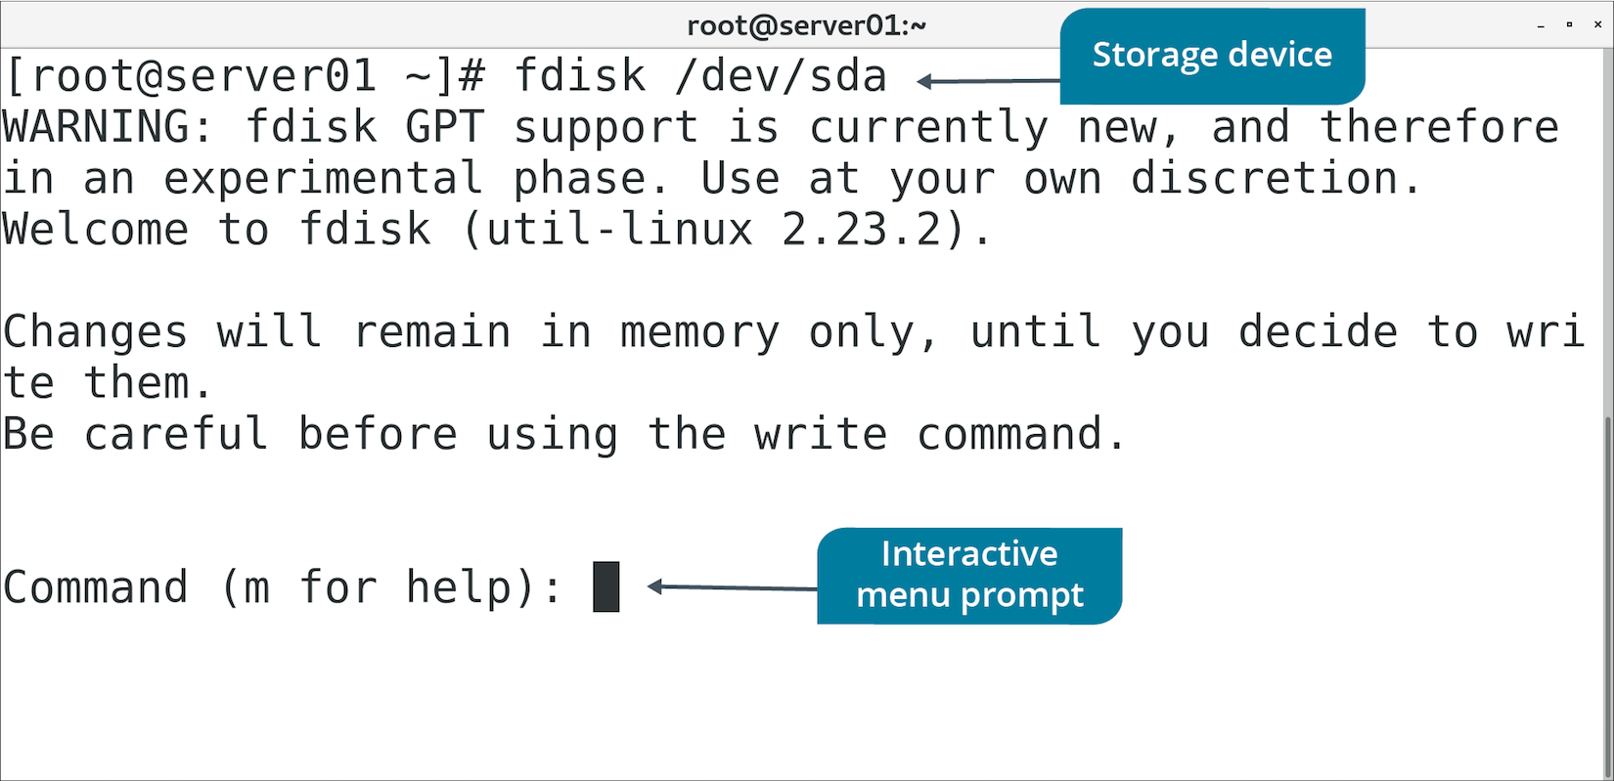
The fdisk Utility (Slide 2 of 2)

Slide 17
fdisk Menu Options (Slide 1 of 2)
Option | Used To
n | Create a new partition.
d | Remove a partition.
p | List existing partitions.
w | Write changes to drive and exit utility.
q | Cancel changes made and exit utility.

Slide 18
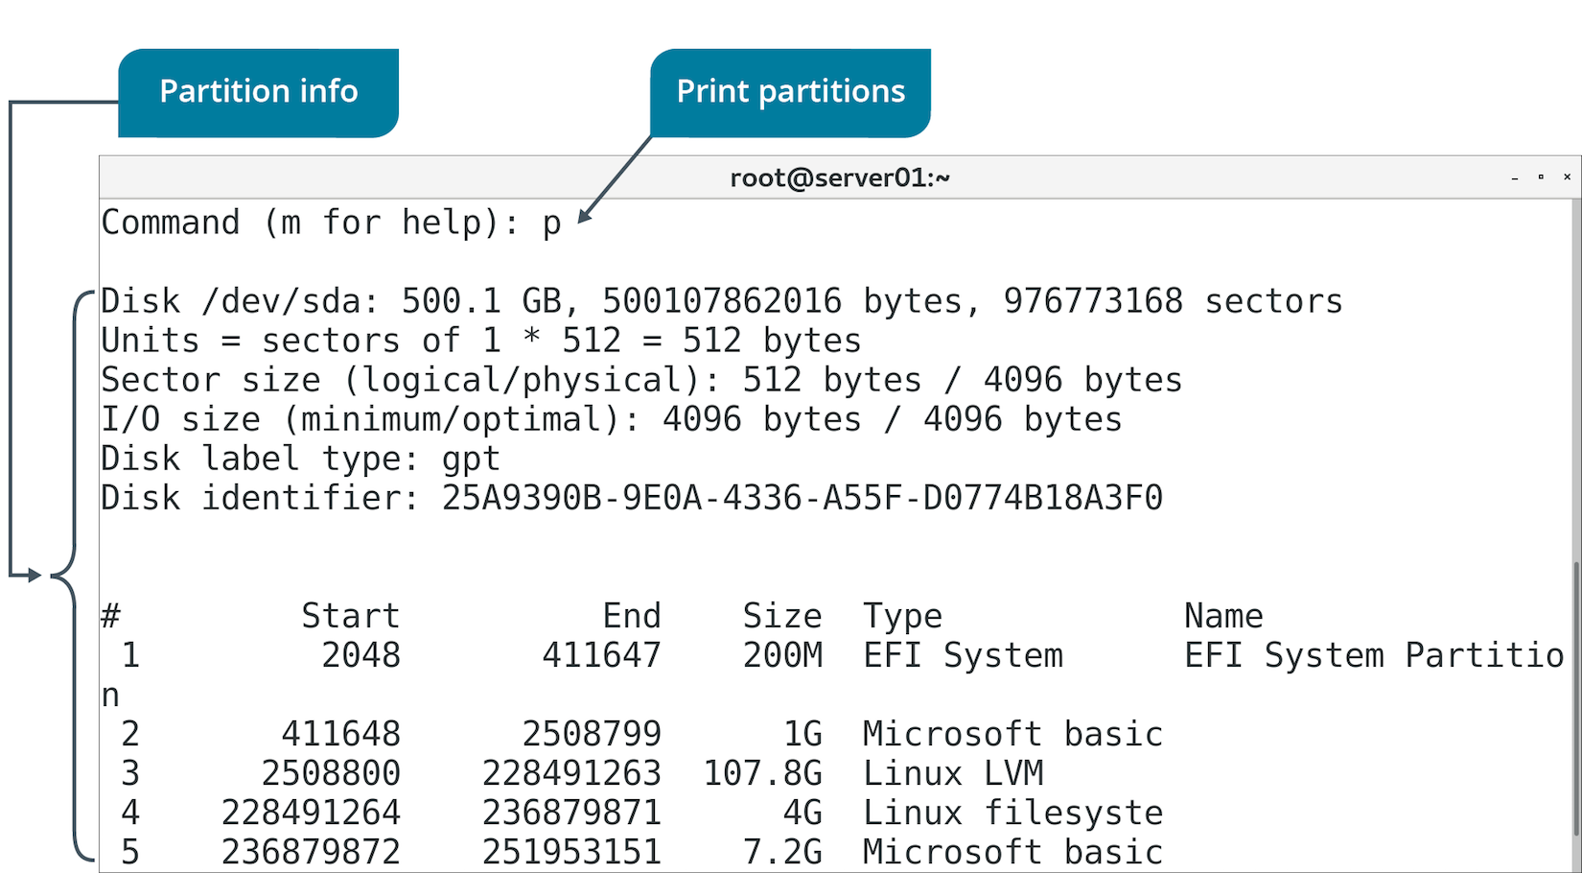
fdisk Menu Options (Slide 2 of 2)

Slide 19
GNU Parted (Slide 1 of 2)
A utility used to manage partitions.
Useful when creating partitions on new drives.
Can create, destroy, and resize partitions.
Run by issuing parted command.
Includes menu-driven interactive mode.

Slide 20
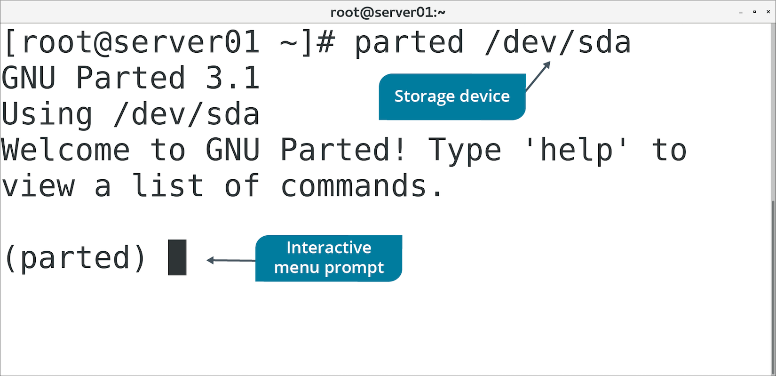
GNU Parted (Slide 2 of 2)

Slide 21
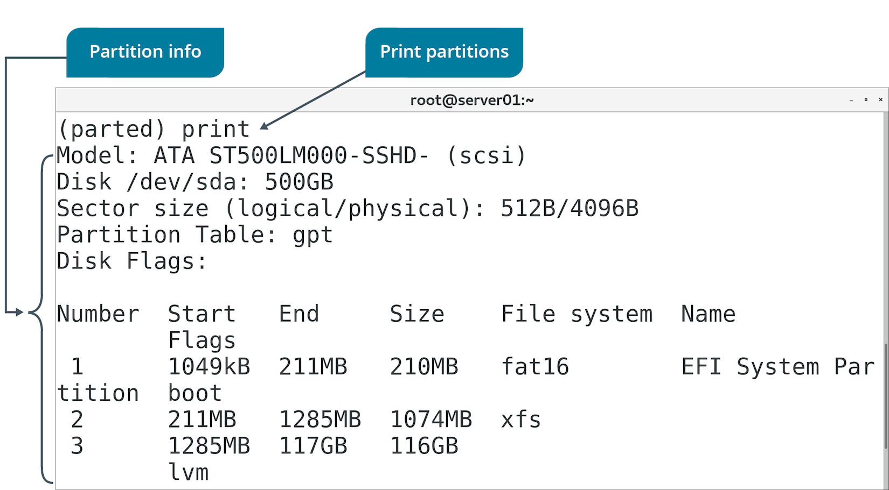
GNU Parted Menu Options (Slide 1 of 2)

Slide 22
GNU Parted Menu Options (Slide 2 of 2)
Option | Used To
select | Choose which device/partition to modify.
mkpart | Create partition with specified file system type.
print | List partition table.
resizepart | Modify end position of partition.
rm | Delete partition.
quit | Exit utility.

Slide 23
The partprobe Command (Slide 1 of 2)
Updates kernel with changes to partition table.
Checks table first, then updates kernel if it finds any changes.
Kernel needs to reference partition table for new partitions.
Can't add file system to new partition otherwise.
Might get partition table error during fdisk operation.
You can reboot to update the table.
Or, use partprobe to update it without a reboot.
Comes with GNU parted.

Slide 24
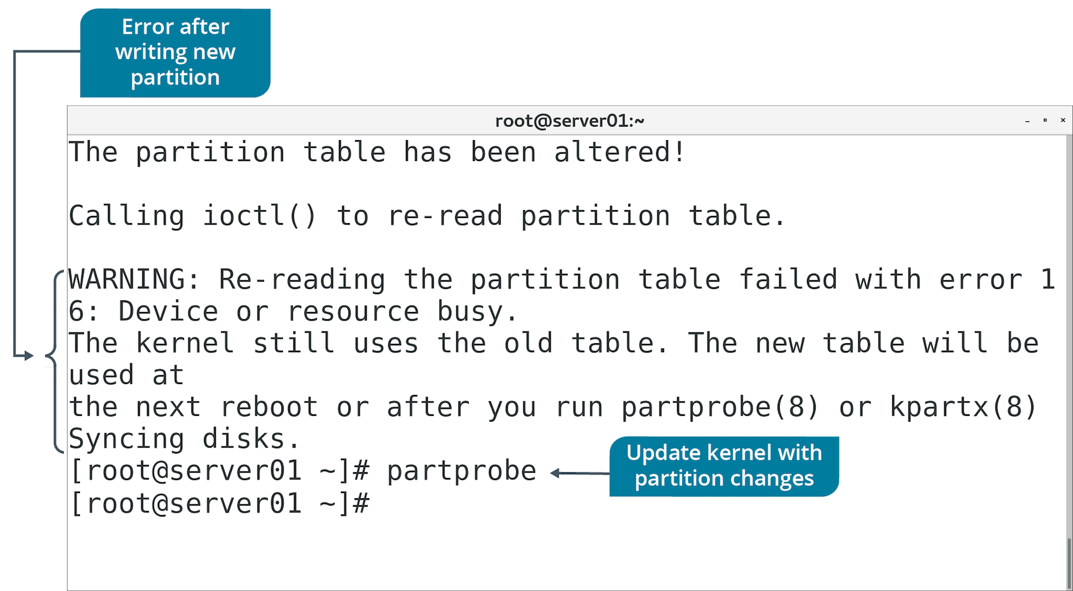
The partprobe Command (Slide 2 of 2)

Slide 25
The mkfs Command (Slide 1 of 2)
Used to build a Linux file system on a device/partition.
Option | Used To
-v | Produce verbose output.
-V | Produce verbose output including file system-specific commands.
-t {fstype} | Specify type of file system to build.
fs-options | Pass file system-specific options to builder.
-c | Check device for bad blocks before building.
-l {file name} | Read list of bad blocks from file.

Slide 26
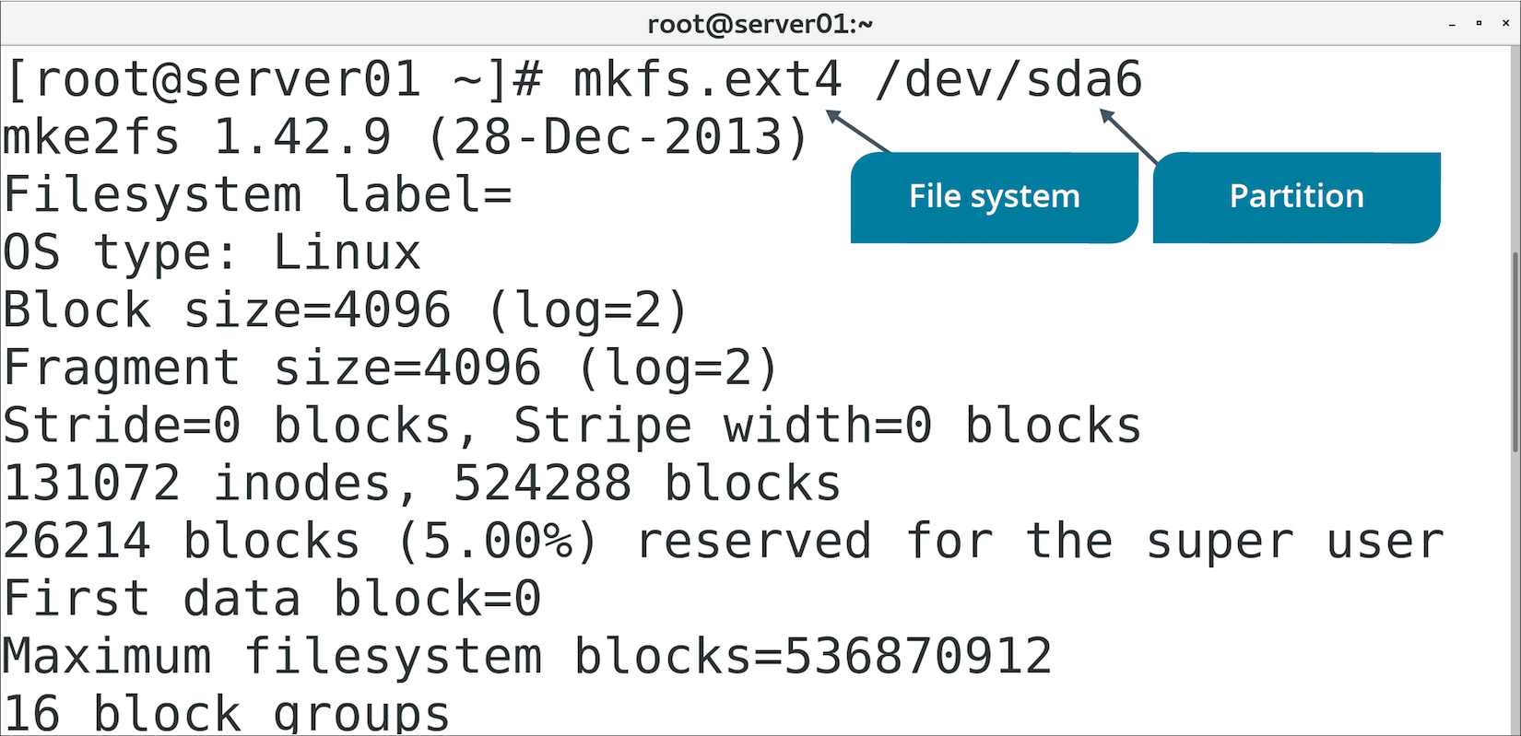
The mkfs Command (Slide 2 of 2)

Slide 27
The fstab File (Slide 1 of 2)
Configuration file that stores device, partition, and mount info.
Located in /etc directory.
Only root can edit.
Consists of one line for each file system.
Field | Description
Device/partition name | Name of device/file system to mount.
Default mount point | Where to mount file system.
File system type | Type of file system used by device/partition.
Mount options | Values activated when file system is mounted.
dump options | Indicates if dump should back up file system.
fsck options | Order in which fsck should check file system.
Notes:
Teaching Tip: Mounting and the fsck utility are covered later.

Slide 28
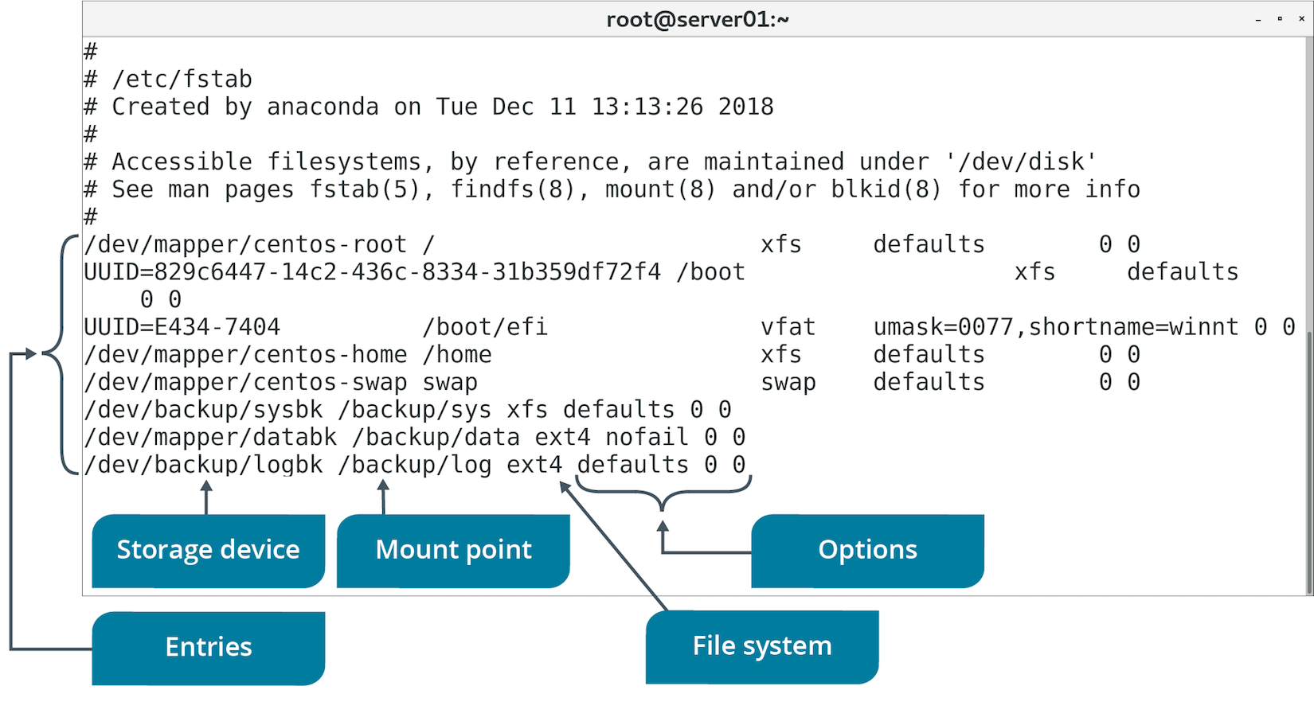
The fstab File (Slide 2 of 2)

Slide 29
The Storage Device Setup Process
Partition the storage device.
Format the partition with a file system.
Add the partition to the fstab file so it is configured on boot.

Slide 30
The /dev/ Directory
Contains files that represent and support attached devices.
Linux uses naming conventions for system to easily locate devices.
Naming convention usually consists of three parts.
/dev/sda1
sd refers to type of controller (in this case, SCSI/SATA).
a refers to first whole drive.
1 refers to first partition on drive.
You'll use this naming convention when managing drives/partitions.

Slide 31
Discussing Partitions

Slide 32
Activity 4-1: Discussing Partitions
You're a new system administrator and your manager comes to your cubicle to give you a pop quiz over a few concepts. The first one she asks you is to show her how you would set up a new partition on the second storage drive on a Linux system. Which command can you enter to perform this operation?
ANSWER:
sudo fdisk /dev/sdb

Slide 33
Activity 4-1: Discussing Partitions
A junior administrator asks for your help with setting up a new Linux file system, /dev/sdb2. He retraces his steps with fdisk, creating the partition and saving the setup. But now, he can't figure out why he can't use the file system—how can you help him?
ANSWER:
After inspecting his work in fdisk, you tell him that he must build the file system with the mkfs command. You assist him by entering the following command: sudo mkfs.ext4 /dev/sdb2

Slide 34
Activity 4-1: Discussing Partitions
You created a new partition, /dev/sdb1, created the file system (XFS), and mounted the file system as /Files. You also created a few directories on /Files for various groups within your organization as shared file spaces. After a maintenance reboot a few days later, users are complaining that their directories and files that you set up no longer exist. What is the problem?
ANSWER:
You didn't make an entry for the new partition in /etc/fstab, therefore, the file system didn't mount on boot.

Slide 35
Activity 4-1: Discussing Partitions
One of the developers has told your manager that he needs the file system /code rebuilt using the XFS file system type. Which utility can you
ANSWER:
use?mkfs.xfs

Slide 36
Activity 4-1: Discussing Partitions
You and the other system administrators have a maintenance partition, /maint, that you only want mounted when required for administrative activities. How can you use the file system only when you need it?
ANSWER:
Don't make an entry for /maint in the /etc/fstab file. Only mount the file system when you need it and then unmount it when finished.

Slide 37
Activity: Creating Partitions
Develetech is concerned about losing data.
You'll create partitions for backups:
System files (XFS).
Business files/user data (ext4).
You'll just create them for now.

Slide 38
Topic B: Manage Logical Volumes
Exam Objectives:
1.4 Given a scenario, manage storage in a Linux environment.
4.1 Given a scenario, analyze system properties and remediate accordingly.

Slide 39
Device Mapping
The process of abstracting physical storage devices into virtual storage devices.
Device mapper creates virtual device.
Passes data from virtual device to one or more physical devices.
Several apps leverage device mapper.
Volume encryption/integrity checking apps.
Act upon data transmitted between physical and virtual devices.

Slide 40
Logical Volume Manager (Slide 1 of 2)
Software that maps physical devices and partitions to logical volumes.
Leverages device mapper.
Maps physical devices to containers called volume groups.
Volume groups contain one or more logical volumes.
Logical volumes are the endpoints that system/user/apps work with.
Many distros support LVM.

Slide 41
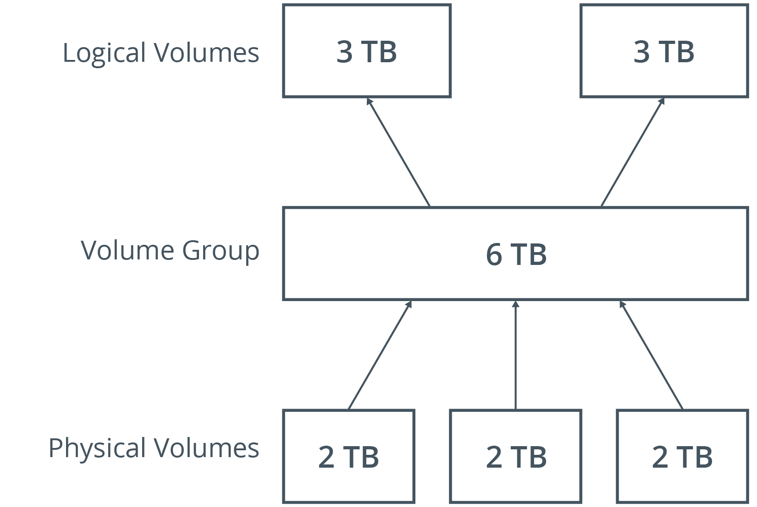
Logical Volume Manager (Slide 2 of 2)

Slide 42
LVM Advantages
Compared to physical partition management:
You can dynamically manage volumes without having to reboot.
Day-to-day volume management is easier.
You can map multiple logical volumes across multiple physical devices.
Logical volumes can exceed the size of any one physical device.
You can create snapshots of logical volumes.
Downside: Initial setup can be complex.

Slide 43
The /dev/mapper/ Directory
Contains all logical volumes on system managed by LVM.
Format:
/dev/mapper/<volume group name>-<logical volume name>
May include links to actual volume location.

Slide 44
LVM Tools
Three categories:
Physical volume (PV) tools
Volume group (VG) tools
Logical volume (LV) tools

Slide 45
PV Tools
Tool | Used To
pvscan | Scan for all physical devices used as PVs.
pvcreate | Initialize drive/partition as a PV.
pvchange | List attributes of PVs.
pvs | Display info about PVs.
pvck | Check metadata of PVs.
pvremove | Remove PVs.

Slide 46
VG Tools (Slide 1 of 2)
Tool | Used To
vgscan | Scan all physical devices for VGs.
vgcreate | Create VGs.
vgdisplay | List attributes of VGs.
vgchange | Change attributes of VGs.
vgs | Display info about VGs.
vgck | Check metadata of VGs.

Slide 47
VG Tools (Slide 2 of 2)
Tool | Used To
vgrename | Rename VGs.
vgreduce | Remove physical volumes from VGs.
vgextend | Add physical volumes to VGs.
vgmerge | Merge two VGs.
vgsplit | Split VG into two.
vgremove | Remove VGs.

Slide 48
LV Tools (Slide 1 of 2)
Tool | Used To
lvscan | Scan all physical devices for LVs.
lvcreate | Create LVs in a VG.
lvdisplay | List attributes of LVs.
lvchange | Change attributes of LVs.
lvs | Display info about LVs.

Slide 49
LV Tools (Slide 2 of 2)
Tool | Used To
lvrename | Rename LVs.
lvreduce | Reduce size of LVs.
lvextend | Extend size of LVs.
lvresize | Resize LVs.
lvremove | Remove LVs.

Slide 50
Discussing Logical Volumes

Slide 51
Activity 4-3: Discussing Logical Volumes
You need to create a new volume for Human Resources. That group has purchased a new 1 TB drive for their volume. What is the first step in the process of creating the logical volume?
ANSWER:
Create a partition using fdisk or a similar tool.

Slide 52
Activity 4-3: Discussing Logical Volumes
How can you create a physical volume on /dev/sdd1?
ANSWER:
pvcreate /dev/sdd1

Slide 53
Activity 4-3: Discussing Logical Volumes
How can you remove the physical volume /dev/sde1?
ANSWER:
pvremove /dev/sde1

Slide 54
Activity 4-3: Discussing Logical Volumes
Which command can you use to create a new volume group, shared, with /dev/sdb1 and /dev/sdd1? And then how do you view your volume groups?
ANSWER:
1) vgcreate shared /dev/sdb1 /dev/sdd1 2) vgdisplay

Slide 55
Activity 4-3: Discussing Logical Volumes
Which command can you use to create a new 400 GB logical volume, finance, from volume group vg_finance?
ANSWER:
lvcreate --name finance --size 400G vg_finance

Slide 56
Activity: Managing Logical Volumes
There are more efficient ways of managing storage.
You'll consolidate space on both partitions.
Create a physical volume using LVM.
Create a volume group and logical volumes.
You also need a third backup space for log files.
Space requirements might fluctuate.
Logical volume will work better than a physical partition.

Slide 57
Topic C: Mount File Systems
Exam Objectives:
1.4 Given a scenario, manage storage in a Linux environment.

Slide 58
Mount Points
An access point to information stored on a local or remote storage device.
File system is loaded (mounted) to make it accessible.
Typically mounted on empty directory.
If directory has content, content is invisible until file system is unmounted.

Slide 59
The mount Command
Loads file system into directory.
Makes file system usable.
You must specify device to mount and mount point.

Slide 60
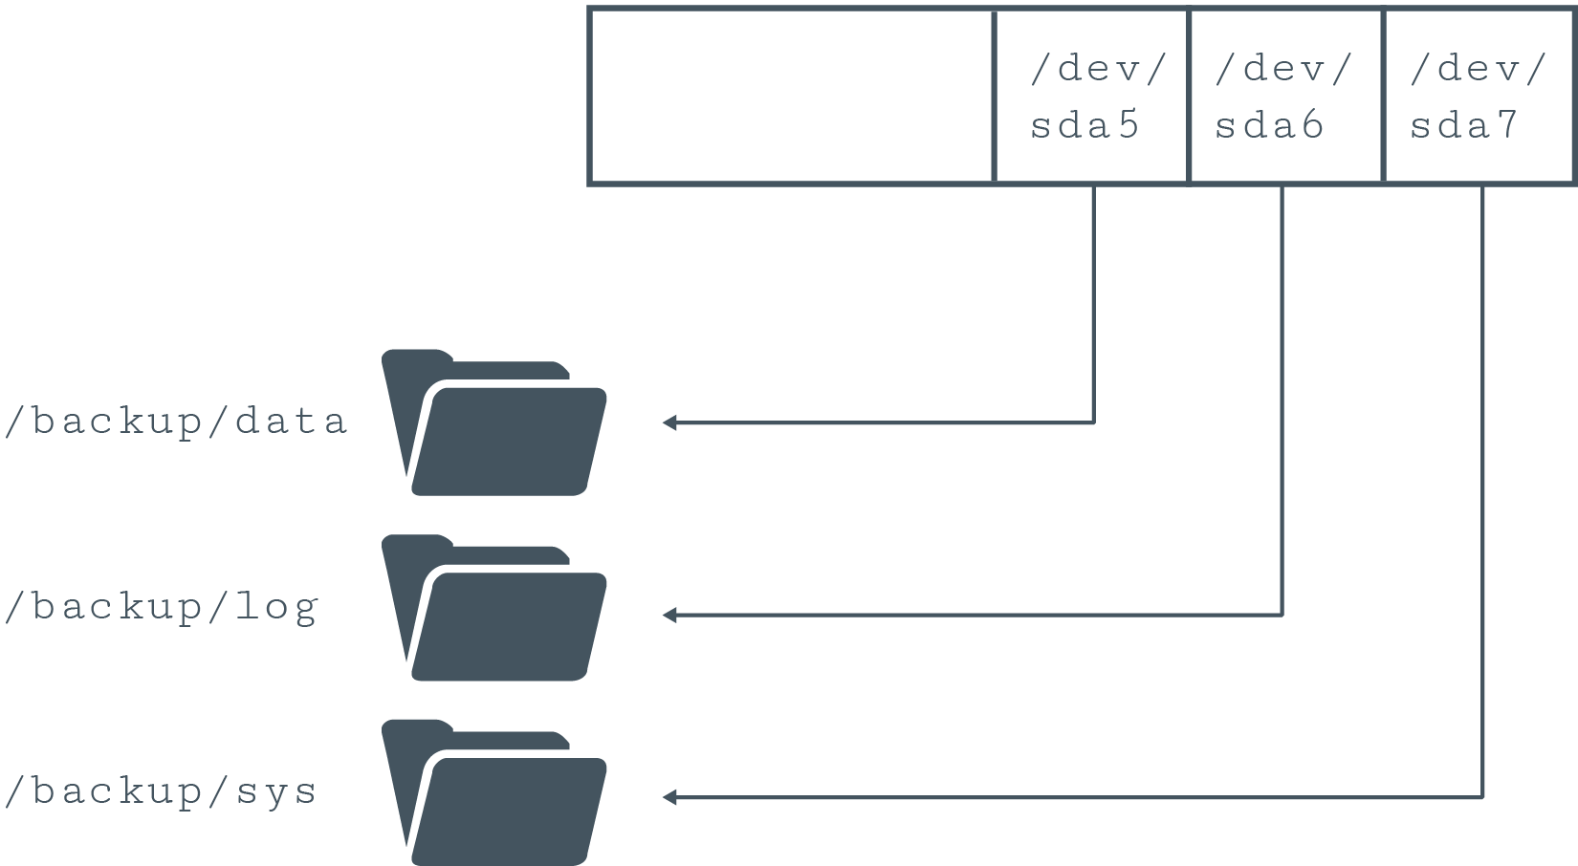
Mounting Partitions to Directories

Slide 61
mount Options (Slide 1 of 2)
Option | Used To
auto | Specify device must be mounted automatically.
noauto | Specify device shouldn't be mounted automatically.
nouser | Specify only root user can mount device.
user | Specify all users can mount device.
exec | Allow execution of binaries in a file system.

Slide 62
mount Options (Slide 2 of 2)
Option | Used To
noexec | Prevent execution of binaries in a file system.
ro | Mount file system as read-only.
rw | Mount file system with read and write permissions.
sync | Specify I/O operations should be done synchronously.
async | Specify I/O operations should be done asynchronously.

Slide 63
The umount Command
Disassociates file system from mount point.
File system must not be in use.
Example: App has a file open.

Slide 64
Discussing Mounting File Systems

Slide 65
Activity 4-5: Discussing Mounting File Systems
What are the three requirements for mounting a file system?
ANSWER:
1) A device (/dev/sdb1, for example) 2) A directory (mount point) 3) Root/superuser privileges.

Slide 66
Activity 4-5: Discussing Mounting File Systems
What final task do you need to complete in mounting a new file system to have that new file system mount at boot time?
ANSWER:
Add its entry to the /etc/fstab file.

Slide 67
Activity 4-5: Discussing Mounting File Systems
What is the generic format of the /etc/fstab file?
ANSWER:
<Device or UUID> <Mount point> <File system type> <Mount option> <Dump option> <fsck option>

Slide 68
Activity 4-5: Discussing Mounting File Systems
How can you unmount the /finance file system?
ANSWER:
sudo umount /finance

Slide 69
Activity 4-5: Discussing Mounting File Systems
If you issue the following command: sudo umount /share1 and you receive the error that the resource is busy, how do you fix the problem and unmount the file system?
ANSWER:
A program or user, possibly you, is using the /share1 directory. You must close the program or otherwise ensure that it, yourself, or other users are not accessing the file system.

Slide 70
Activity: Mounting File Systems
Your volumes aren't usable yet; need to mount them first.
Mount points:
/backup/sys/
/backup/data/
/backup/log/
Volumes should mount automatically on boot.

Slide 71
Topic D: Manage File Systems
Exam Objectives:
1.4 Given a scenario, manage storage in a Linux environment.
2.7 Explain the use and operation of Linux devices.
4.1 Given a scenario, analyze system properties and remediate accordingly.

Slide 72
The /proc/mounts File
Lists status of all currently mounted file systems.
Format similar to fstab
Not a real file; part of virtual file system.
Represents status of file systems as reported by kernel.
Typically read using cat or similar command.
Lists all file systems, not just storage drives/partitions.

Slide 73
The /proc/partitions File (Slide 1 of 2)
Contains info about each partition.
Not a real file; part of VFS.
Column format:
major
minor
#blocks
name

Slide 74
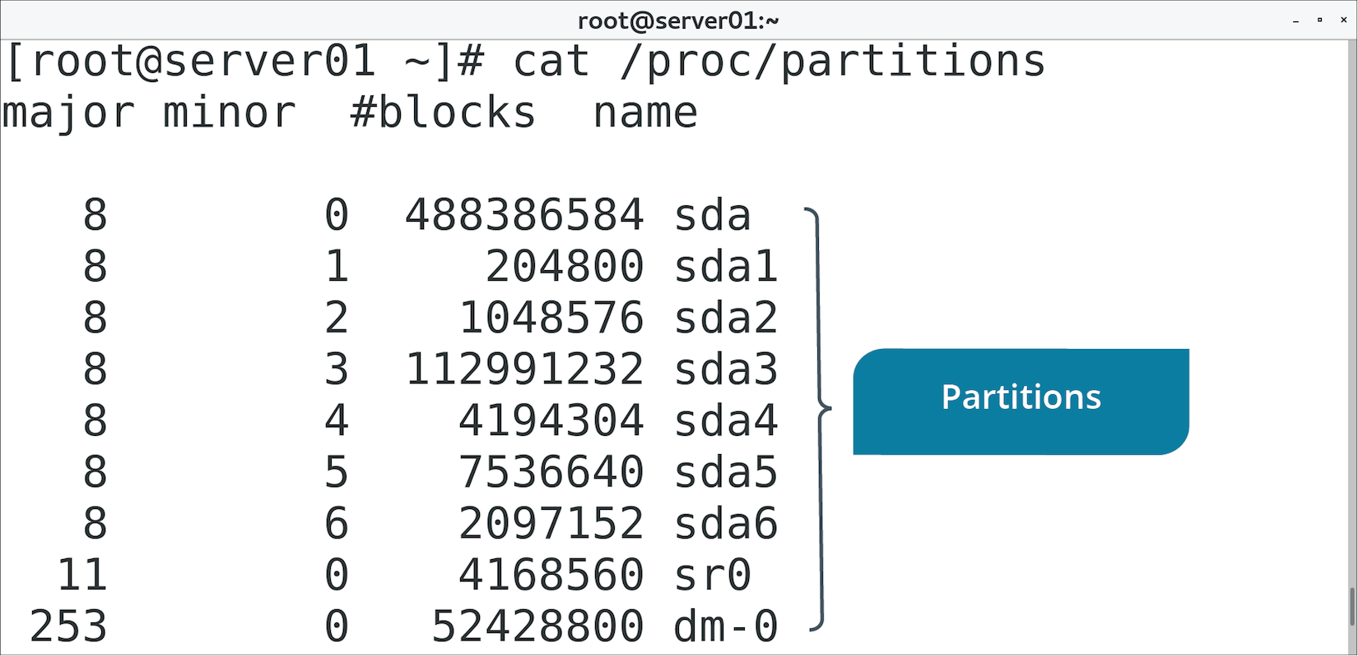
The /proc/partitions File (Slide 2 of 2)

Slide 75
The lsblk Command (Slide 1 of 2)
Displays info about all block storage devices.
Output is in tree-like format.
Physical devices at top, partitions/logical volumes branch off.
Displays names, major/minor numbers, type, mount point.

Slide 76
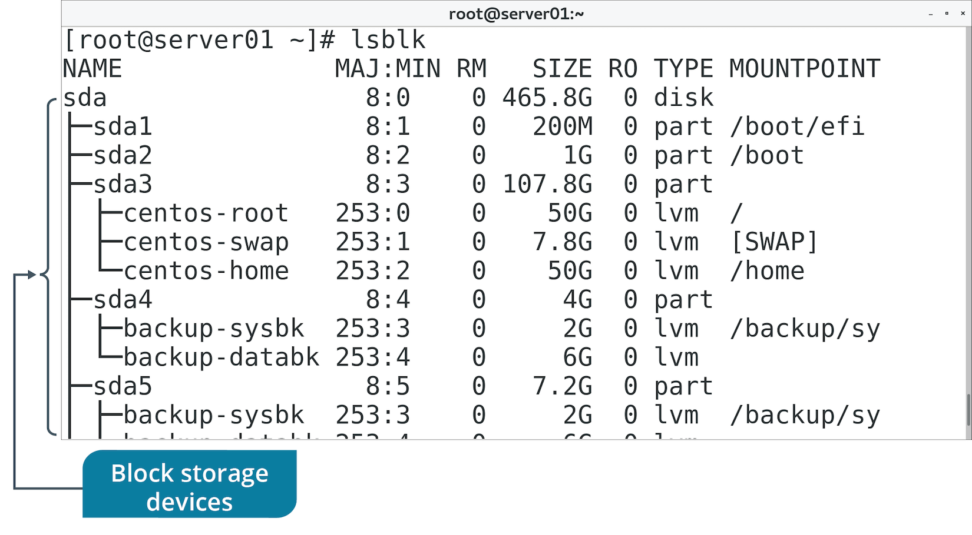
The lsblk Command (Slide 2 of 2)

Slide 77
The blkid Command
Similar to lsblk command.
Prints block device info in flat format.
Includes additional info like UUIDs and file system types.
Using lsblk -f is preferable.

Slide 78
ext Tools
Some tools are designed to work with specific file system types.
Several tools can work with ext2/3/4:
e2fsck
resize2fs
tune2fs
dumpe2fs

Slide 79
The fsck Command (Slide 1 of 2)
Checks integrity of file system.
Integrity refers to correctness and validity of file system.
Most systems run fsck at boot.
Errors usually caused by power/hardware failures or improper shutdown.
Unmount file system before using fsck to prevent damage.

Slide 80
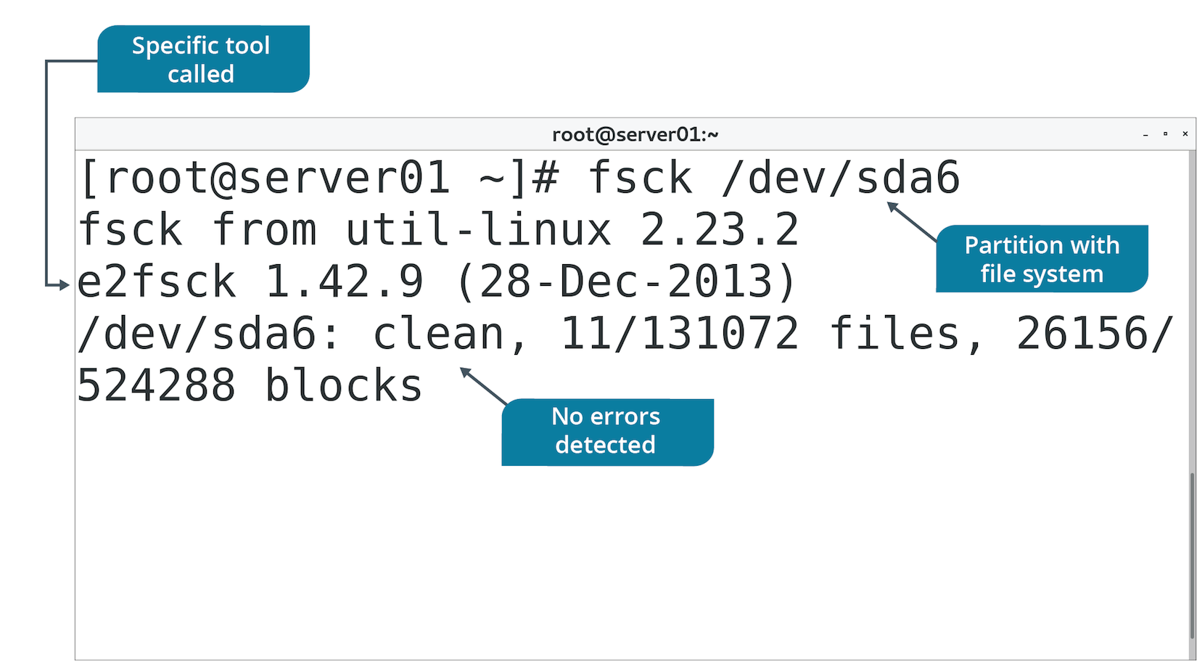
The fsck Command (Slide 2 of 2)

Slide 81
The resize2fs Command
Enlarges or shrinks ext2/3/4 file system.
Must unmount file system to shrink it.
You can specify desired size of file system.
If you don't, it gets resized to size of partition.
Does not resize partitions, only file systems.
Use fdisk or LVM tools to expand size of partition/volume first.

Slide 82
The tune2fs Command
Configures tunable parameters on ext2/3/4 file systems.
Tunable parameters enable you to:
Remove reserved blocks.
Alter reserved block count.
Specify number of mounts between checks.
Specify time interval between checks.
And more.
You can also use tune2fs to add a journal to ext2/3 file systems.

Slide 83
The dumpe2fs Command (Slide 1 of 2)
Used to dump ext2/3/4 file system info.
Prints superblock and block group info for device.
Useful when troubleshooting faulty file system.

Slide 84
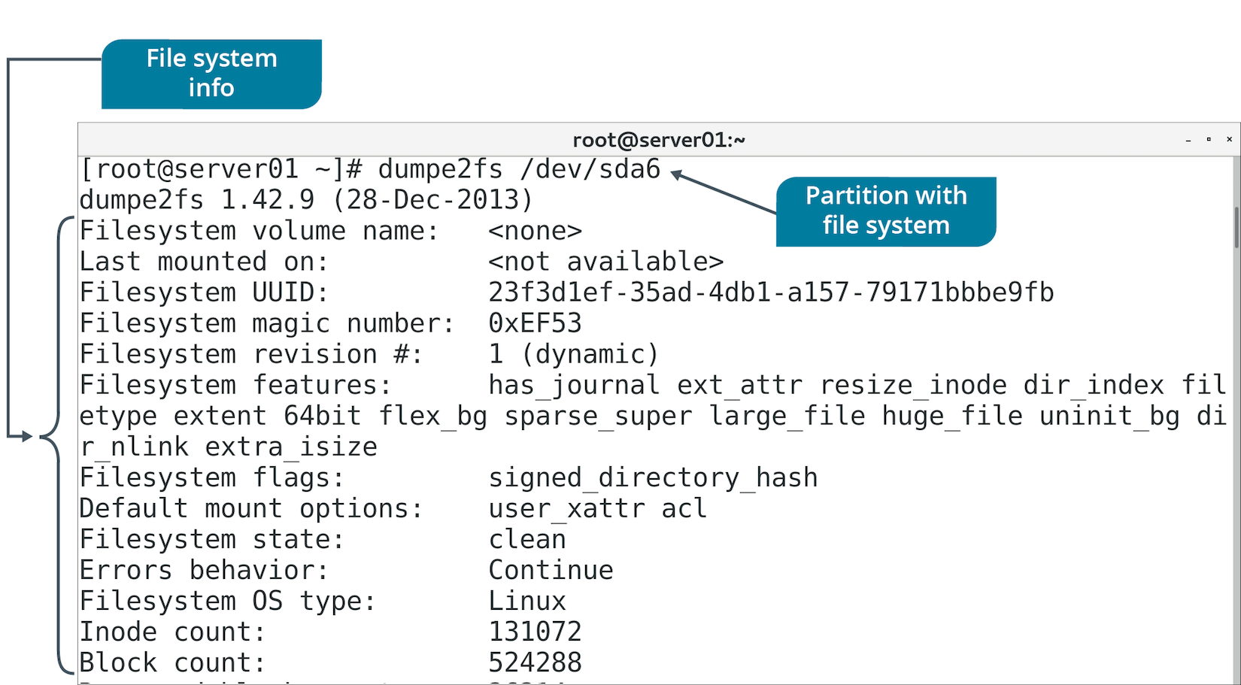
The dumpe2fs Command (Slide 2 of 2)

Slide 85
XFS Tools
Tool | Used To
xfs_info | Display details about file system.
xfs_admin | Change parameters of file system.
xfs_metadump | Copy superblock metadata of file system to a file.
xfs_growfs | Expand file system to fill drive size.
xfs_copy | Copy contents of file system to another location.
xfs_repair | Repair and recover corrupt file system.
xfs_db | Debug file system.

Slide 86
Discussing Managing File Systems

Slide 87
Activity 4-7: Discussing Managing File Systems
What are the steps required to grow the file system /dev/data/datastore1 from its current 200 GB size to 400 GB?
ANSWER:
1) sudo umount /dev/data/datastore1 2) sudo e2fsck -f /dev/data/datastore1 3) sudo lvextend -L400G /dev/data/datastore1 4) sudo resizefs /dev/data/datastore1 5) sudo mount /dev/data/datastore1 /data1

Slide 88
Activity 4-7: Discussing Managing File Systems
Why should you have to unmount a file system prior to performing an fsck on it?
ANSWER:
You should unmount the file system to prevent damage such as file corruption.

Slide 89
Activity 4-7: Discussing Managing File Systems
You know that for ext4 file systems, you use the resizefs utility to grow the file system, but which utility can you use to perform this same action on XFS file systems?
ANSWER:
xfs_growfs

Slide 90
Activity 4-7: Discussing Managing File Systems
Another system administrator appears in your cubicle and asks you to display storage devices and their file systems on server05. Which command can you use to show him the info he needs?
ANSWER:
sudo lsblk -f

Slide 91
Activity 4-7: Discussing Managing File Systems
You have a coworker who attempted to grow a file system on a Linux server. His problem is that the file system didn't extend despite entering the following command: sudo lvextend -L150G /dev/shared/graphics —He remounted the file system onto /Graphics but the new space doesn't show up. What is the issue?
ANSWER:
He forgot to issue the resizefs command to actually resize the file system. The lvextend command extends the partition size but does not affect the file system.

Slide 92
Activity: Managing File Systems
You want to perform scheduled maintenance on volumes.
Check them for errors.
Size of volumes needs to increase.
Must change file system size as well.

Slide 93
Topic E: Navigate the Linux Directory Structure
Exam Objectives:
1.4 Given a scenario, manage storage in a Linux environment.

Slide 94
Types of Files
File Type | Description
Directories (d) | Container for other files.
Special files | Includes block special files (b) and character special files (c).
Links (l) | Makes files accessible to other parts of file system tree.
Domain sockets (s) | Provides inter-process networking.
Named pipes (p) | Enables process communication without network sockets.

Slide 95
File Naming Conventions
Ensure file names are unique and easy to recognize.
On ext4, file name:
Up to 255 bytes.
No NULL character or forward slash.
The names . and .. are reserved.
Different file systems enforce different rules.
Spaces are possible in file names, but not preferred.
Consider demarcating words by hyphens or underscores:
audit-file.txt
audit_file.txt

Slide 96
The Filesystem Hierarchy Standard
A set of guidelines for the names of files and directories and their locations on Linux systems.
A collaborative document.
Most distros are FHS-compliant.
Supports compatibility between systems.
Creates naming convention to benefit users and software.
Helps them consistently find and store files.

Slide 97
Standard Directories (Slide 1 of 2)
Directory | Description
/bin | Essential command-line utilities/binaries.
/boot | Files necessary to boot Linux.
/dev | Hardware and software device drivers.
/etc | Basic configuration files.
/home | Users' home directories.
/lib | Shared program libraries.
/media | Mount points for removable media.
/mnt | Mount point for temporarily mounting file systems.
Notes:
Teaching Tip: Consider pointing out some of the more significant directories, such as /dev, / etc, /proc, and / var.

Slide 98
Standard Directories (Slide 2 of 2)
Directory | Description
/opt | Optional files or large software packages.
/proc | VFS that reports kernel information.
/root | Root user's home directory.
/sbin | Binaries used in booting and by the root user.
/sys | VFS storing information about devices.
/tmp | Temporary files.
/usr | Read-only directory of programs/files accessible to all users.
/var | Variable files (expected to constantly change).

Slide 99
The Home Directory (Slide 1 of 2)
A container for the user's personal files or files specific to that user.
Where you are placed when you log in.
User is placed in a subdirectory in /home that corresponds to their user name.
User can create subdirectories/files here.
Home directory of root user is /root
Not to be confused with root directory (/).
Most shells indicate home directory with a tilde (~).
Notes:
Teaching Tip: Consider pointing out that the term "root" can be used in three different ways: the root user, the root user's home directory, and the root of the file system. It's important to be precise when talking about these concepts.

Slide 100
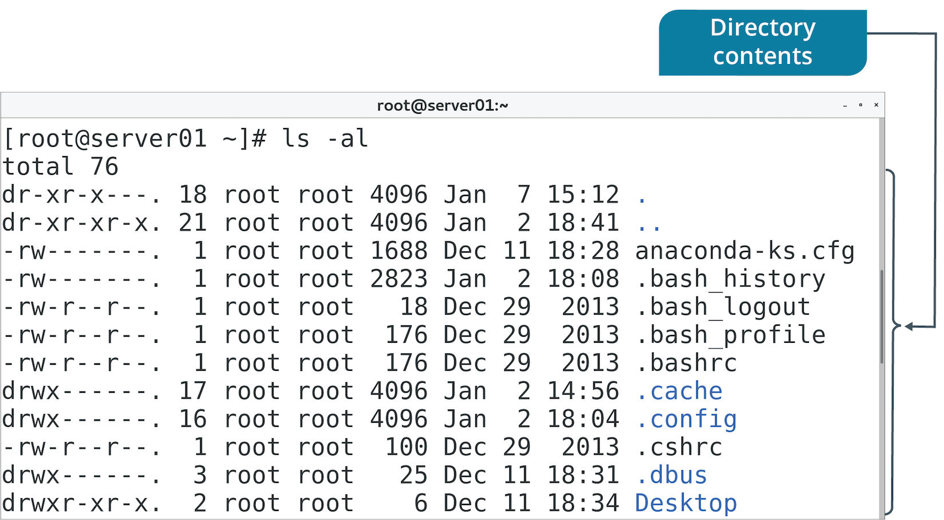
The Home Directory (Slide 2 of 2)

Slide 101
The Current Working Directory
The location that you are accessing at any point in time.
Example: When you log in, your CWD is /home/<user name>
Represented in shorthand by single period (.)
Use pwd to identify.

Slide 102
The Parent Directory
The directory that is one level above your current working directory.
All directories except root (/) have a parent.
Use double periods (..) to switch to parent.

Slide 103
Paths
A specification of an object's location in a file system.
Begins with root directory and ends with file/directory you want to access.
You've worked with paths to access various files/directories.
Refer to a file by providing path to that file.
Home directory is jsmith
Contains subdirectory work
Contains file mywork
Path is: /home/jsmith/work/mywork
Forward slash (/) separates items.
First instance represents root directory.

Slide 104
Absolute vs. Relative Paths
Absolute path is a specific location.
Irrespective of CWD or combined paths.
References root directory.
Starts with forward slash.
Relative path is based on CWD.
Don't begin with forward slash.
Full absolute path not necessary.
Can contain CWD (.) and parent directory (..) indicators.

Slide 105
File System Navigation Commands
Command | Used To
cd | Traverse directory structure to change CWD.
ls | List files/directories in CWD or path specified.
pwd | Print CWD to console.

Slide 106
Discussing the Linux Directory Structure

Slide 107
Activity 4-9: Discussing the Linux Directory Structure
If you cd to the root directory of the file system, name three directories that you'll see there.
ANSWER:
The root of the file system is / and some possibilities are: /etc, /home, /opt, /mnt, /media, /boot, /dev, /proc, /tmp, /var, /lib, /bin, /sbin, /sys, /root, and /usr

Slide 108
Activity 4-9: Discussing the Linux Directory Structure
What standard directory contains system logs?
ANSWER:
/var/ or, more specifically, /var/log/

Slide 109
Activity 4-9: Discussing the Linux Directory Structure
How can you list files in a hidden directory?
ANSWER:
Similar to any other directory, either you cd into the hidden directory and issue the ls command or you explicitly name the hidden directory in your command, such as ls .ssh

Slide 110
Activity 4-9: Discussing the Linux Directory Structure
Explain the difference between /root and /
ANSWER:
The /root directory is the root user's home directory and / is the root of the file system.

Slide 111
Activity 4-9: Discussing the Linux Directory Structure
If you cd into /opt/log/first/test/test1 and then type cd ~ and press Enter, which directory is now your current working directory?
ANSWER:
Your home directory. If your user name is bsmith, this is /home/bsmith. The cd ~ command returns you to your home directory regardless of where you are on the file system.

Slide 112
Activity: Navigating the Linux Directory Structure
You need to become more familiar with the Linux file structure.
You'll be able to find what you're looking for more easily.
You'll walk through several main directories.

Slide 113
Topic F: Troubleshoot Storage Issues
Exam Objectives:
1.4 Given a scenario, manage storage in a Linux environment.
2.2 Given a scenario, manage users and groups.
4.1 Given a scenario, apply or acquire the appropriate user and/or group permissions and ownership.

Slide 114
Common Storage Issues
Missing devices
Missing volumes
Missing mount points
Degraded storage
Performance issues
Resource exhaustion
Storage integrity/bad blocks
Notes:
Teaching Tip: Several of the concepts mentioned here are expanded on later in the course.

Slide 115
Storage Space Tracking (Slide 1 of 2)
The df command displays device's:
Free space
File system
Total size
Percentage of space used
Mount point
The du command displays file or directory sizes.
Can track space hogs.
Go-to commands for troubleshooting space issues.

Slide 116
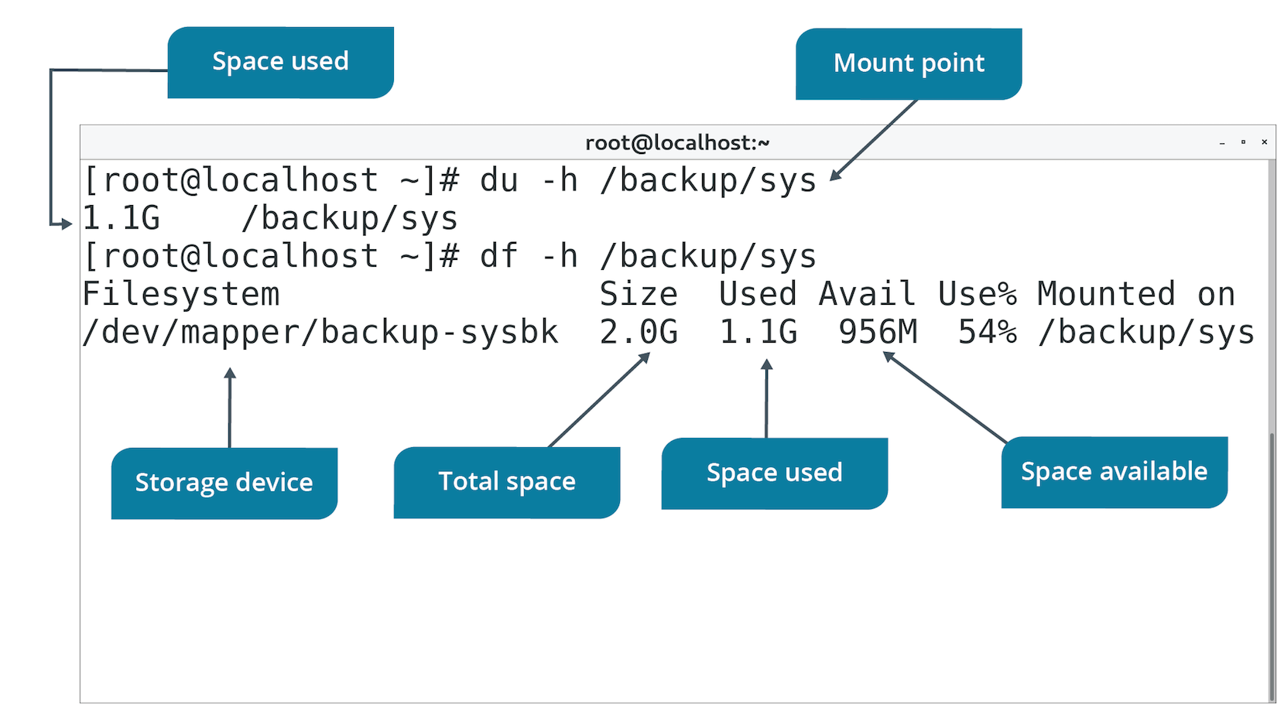
Storage Space Tracking (Slide 2 of 2)

Slide 117
I/O Scheduling
The process by which the OS determines the order of I/O operations as they pertain to block storage devices.
Block storage operations are slow compared to CPU/memory operations.
Especially in disk-based technology.
Kernel doesn't just begin reading/writing in order requests are submitted.
Instead, it prioritizes some requests over others.
Minimizes performance issues.
You can configure scheduler with different behavior types.
Some are more suited to certain workloads.

Slide 118
Scheduler Types
Type | Description
deadline | Uses standard pending request queue, read FIFO queue, and write FIFO queue. FIFO queues sorted by submission time and have expiration. Request is sorted into standard queue and placed at end of FIFO queue. Stops servicing standard queue when request in FIFO queue exceeds expiration. Ensures scheduler doesn't starve a request. Ideal in multi-threaded workloads.
cfq | Each process has its own queue and queue has a time slice. Scheduler uses round-robin system for accessing each queue. Waits until time slice or requests are exhausted. Waits for a new request, and if there isn't one, it moves on to next queue. Minimizes starvation. Services processes fairly with good overall performance. Default scheduler of Linux kernel.
noop | Simple; doesn't sort, just merges requests. Ideal when device does its own sorting. Ideal for SSDs, USB drives, etc. Other two schedulers are preferred for standard HDDs.

Slide 119
The iostat Command (Slide 1 of 2)
Generates reports on CPU and device usage.
Provides I/O stats for block storage devices.
Use -d option to display only device info.
Stats:
tps
kB_read/s
kB_wrtn/s
kB_read
kB_wrtn
Use report to monitor storage drives and identify bottlenecks.
Faulty drive might have low reads/writes per second.
Can help you decide how to distribute I/O across devices.

Slide 120
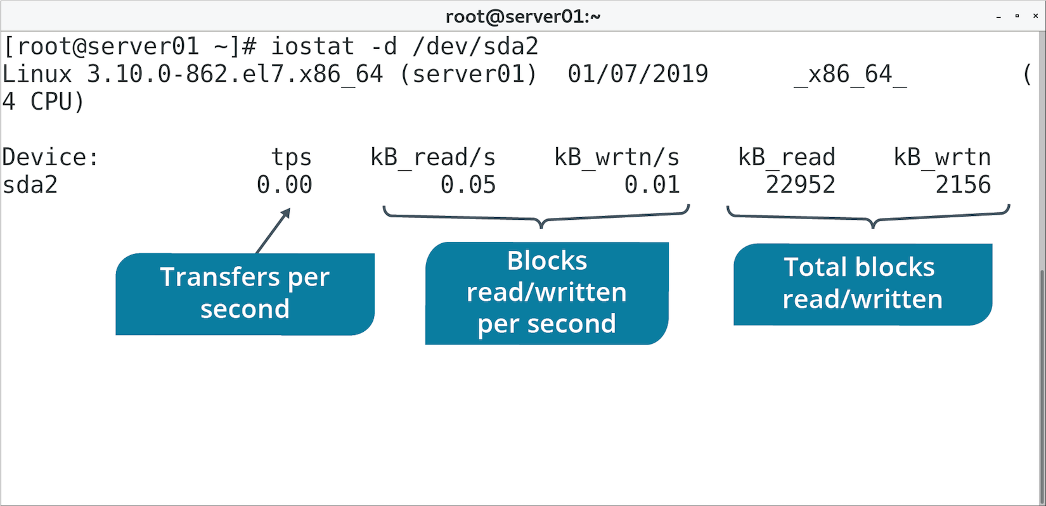
The iostat Command (Slide 2 of 2)

Slide 121
The ioping Command (Slide 1 of 2)
Generates report of device I/O latency in real-time.
Continuously "pings" device with requests.
Prints info about requests at CLI.
Tracks how long it took for I/O request to finish.
You can also specify path name to test associated device.
Use ioping to troubleshoot latency issues with storage devices.
Especially if read/write speeds are too slow.

Slide 122
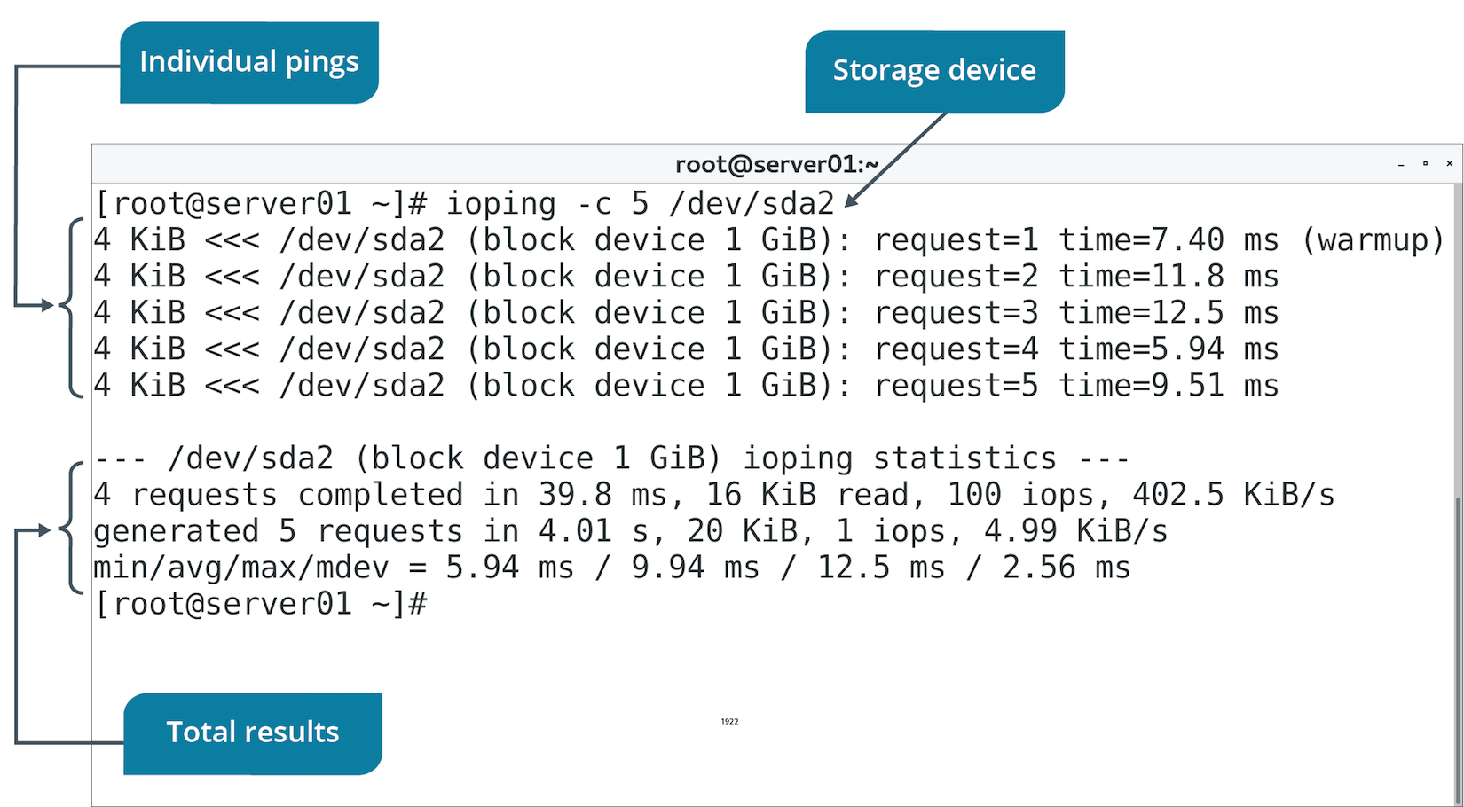
The ioping Command (Slide 2 of 2)

Slide 123
Storage Quotas
The storage space that is allotted to a user for file storage on a computer.
Configured per user.
Include soft limit, grace period, and hard limit.
User is placed in grace period if they exceed soft limit.
User can continue past this limit in the grace period, but can't exceed hard limit.
If user goes under soft limit, timer resets.
If user stays above soft limit when timer expires, soft limit becomes a hard limit.
Won't be able to use additional storage.
Good for preventing or responding to storage consumption issues.
Can ensure users aren't taking up too much space.

Slide 124
Quota Management Commands
Command | Used To
quotacheck -cug {mount point} | Create quota database files for file system and check user/group quotas.
edquota -u {user name} | Edit quotas for specific user.
edquota -g {group name} | Edit quotas for specific group.
setquota -u {user name} | Set quotas for specific user.
setquota -g {group name} | Set quotas for specific group.

Slide 125
Quota Reports (Slide 1 of 2)
You can view how storage is being used by each user.
Can help you troubleshoot quota issues.
Details:
Name of user/group.
Total blocks being used.
Soft limited on storage.
Hard limit on storage.
Grace period.
Total inodes being used.
Soft limit on inodes.
Hard limit on inodes.

Slide 126
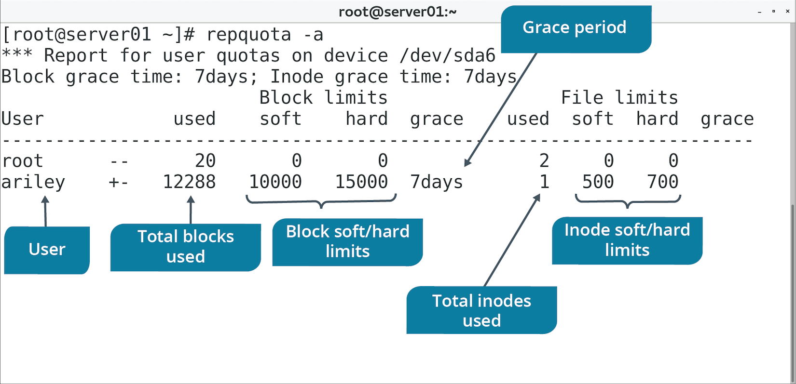
Quota Reports (Slide 2 of 2)

Slide 127
Additional Storage Troubleshooting Techniques
Start with the simple, work toward the complex.
Example: User can't create file.
They have adequate permissions.
Check if storage is available.
Check if there is free space.
Look for inode exhaustion.
If storage is unavailable:
Verify physical connections.
Check /dev/ and /proc/ to see if system recognizes storage.
Check configuration files for errors.
Use tools like fsck, XFS tools, ext4 tools, etc.

Slide 128
Guidelines for Troubleshooting Storage Issues
Ensure devices are physically connected to system.
Ensure devices are powered.
Ensure devices are turned on.
Verify device is recognized by the system.
Confirm that config files don't contain errors.
Ensure config files have been reloaded if you made changes.
Confirm there is enough storage capacity.
Confirm that I/O workload isn't overwhelming device.
Use partprobe to scan for new storage devices and partitions.

Slide 129
Discussing Storage Issues

Slide 130
Activity 4-11: Discussing Storage Issues
What does the -h switch in the command df -h do for you?
ANSWER:
It presents disk free (df) data in a human-readable format (megabytes and gigabytes) for mounted file systems.

Slide 131
Activity 4-11: Discussing Storage Issues
What does the iostat /dev/sda command do, and how can it be useful in troubleshooting?
ANSWER:
This command generates read and write statistics for the /dev/sda block storage device. It can be useful in troubleshooting because it can help you monitor storage usage statistics and identify poor performance associated with that device.

Slide 132
Activity 4-11: Discussing Storage Issues
Which directory or file system is a likely candidate on which to impose storage quotas on a shared Linux system?
ANSWER:
The /home directory or file system because users tend to store everything without regard to space used. Quotas help prevent this kind of storage waste and file sprawl.

Slide 133
Activity 4-11: Discussing Storage Issues
As an administrator, you attempt to set quotas on /opt/finance for the finance group, but you receive the error that the mount point /opt/finance is not found or has no quota enabled. You verify that /opt/finance exists. You're trying to enable quotas, so it makes no sense that the error is that the file system has no quotas enabled. What is the problem?
ANSWER:
You didn't edit /etc/fstab to add usrquota,grpquota options to the file system you wish to impose quotas on. You also have to unmount/remount this file system after the change is made to /etc/fstab

Slide 134
Activity 4-11: Discussing Storage Issues
Why would an administrator use the ioping utility?
ANSWER:
The ioping utility displays real-time I/O latency data to a specified volume.

Slide 135
Activity: Tracking Storage Space Usage
Users are complaining about poor performance for storage operations.
Some have run into errors about device being full.
Trying to back up their user data.
You'll diagnose the storage issues.
Notes:
Teaching Tip: Work with students to ensure they are entering the correct command.

Slide 136
Activity: Configuring Storage Quotas
Most files on data backup volume were created by [user name]
You want to limit storage space usage for this user.
Limitations:
Block (soft)=10000
Block (hard)=15000
Inode (soft)=500
Inode (hard)=700
Will help prevent issues related to storage.
Notes:
Teaching Tip: The dd command is covered in a later lesson.

Slide 137
Do you or would you prefer to work with standard partitions or logical volumes? Why?
What file system types have you worked with? What advantages and disadvantages have you encountered with each?

